Slide 1
RAJALAKSHMI ENGINEERING COLLEGE
Department of Information Technology
FINAL REVIEW
BATCH ID : 2020ITB08
MOBILE PHONE RECOMMENDER USING MULTI-CRITERIA DECISION MAKING ALGORITHMS
Project by,
SAADANA. S ( 211616205085 )
PRRIYAMVADHAA. M A ( 211616205078 )
PURUSHOTHAMAN. U ( 211616205079 )
Supervisor
Mr.BABU.R(Assistant Professor)

Slide 2
OUTLINE
Objectives
Abstract
Existing system
Limitations of existing system
Proposed system
Advantages of proposed system
Design of the proposed system
Sample dataset
Multi-Criteria Decision Making algorithm
Algorithm of overall process
System flow
Results and discussions
Conclusions
References

Slide 3
OBJECTIVES
The ultimate objective of the proposed system is to provide accurate search results using Multi Criteria Decision Making(MCDM) Algorithm
To create a effective system it involves the integration of two MCDM algorithm-AHP and PROMETHEE
System is aimed to provide an accurate recommendation without any deflection

Slide 4
ABSTRACT
The best smartphones are hard to pick from the diverse brands available across the globe that suits the criteria of the user.
The goal of the project is to provide a platform to users for choosing a suitable smartphone.
The smartphones will be listed based on the filters provided by the users.
Each attribute of filters will have a priority table based on which suggestions will sorted form the highest to the lowest priority.

Slide 5
EXSITING SYSTEM
In e-commerce websites, the users are provided with an option to search the products using its name or any of the specification using filters.
The results which are obtained were purely based on what keyword they are using to perform the search operation.
The products whose data matches with the specified keyword are extracted and display, if no matches are found the it will redirect the user to the homepage.

Slide 6
LIMITATIONS OF EXSITING SYSTEM
No user-specific needs.
The heavy computational cost
The system provides more than the accurate search result when searched.
Divert the user from a specific task in choosing the product
Not focused on the criteria that include the attributes of the product

Slide 7
PROPOSED SYSTEM
The proposed system extracts the required criteria from the customer and the products are listed according to their needs.
It is implemented using the integration of MCDM algorithms. hence, the user does not encounter irrelevant products and provide optimal search results of the mobile
The user interface will be in the form of a commercial website.
The user will be provided an option to enter the filters and assign weightage to individual attributes.

Slide 8
ADVANTAGE OF PROPOSED SYSTEM
In the proposed system, the integration of AHP and PROMETHEE algorithms provides optimal solution and accuracy of the search result obtained is better than existing system
Reduces the confusion in buying the products.
It also avoids the user from getting distracted what they originally need.
encourages people to make valid decision in buying a product.
The algorithm can be used in e-commerce websites for better search results

Slide 9
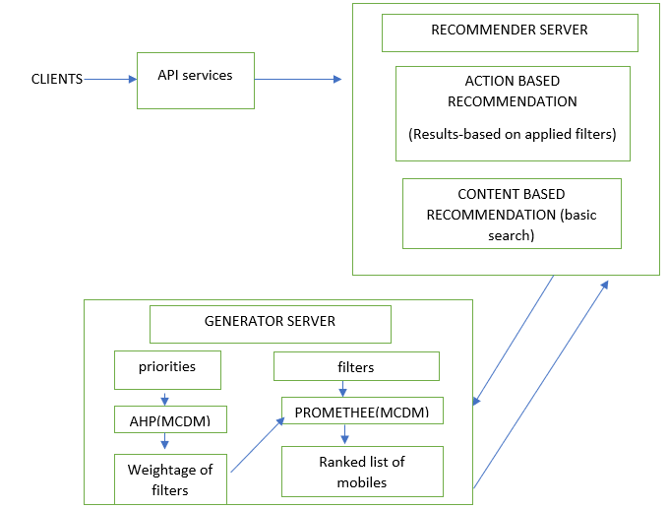
DESIGN OF THE PROPOSED SYSTEM
Fig: Design of the proposed system

Slide 10
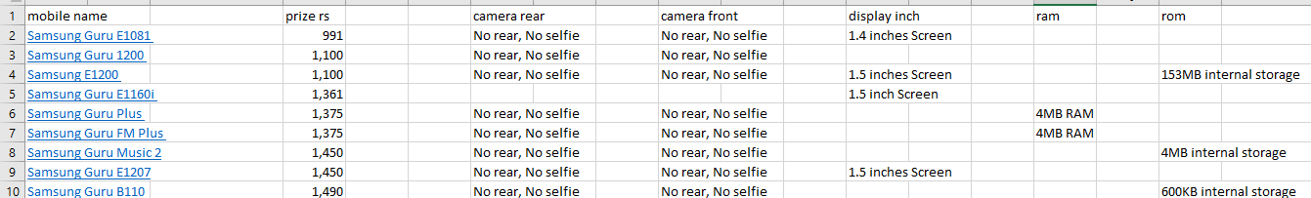
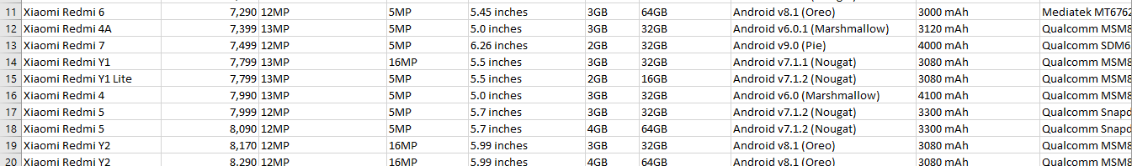
  SAMPLE DATASET
Fig: list of mobile brands and specifications

Slide 11
MULTICRITERIA DECISION MAKING ALGORITHMS
When making decisions, decision-makers (DMs) always attempt to choose the optimal solution. Unfortunately, an optimal solution exists only in case of one single criterion; in real decision situations, almost any decision involves some conflicts or dissatisfaction.
MCDM methods are to help people make their decision consistent with their preferences, in cases where there's quite one conflicting criterion, finding the optimal choice among the alternative.
The system thereby works based on the categorisation of the weights that a user enters.

Slide 12
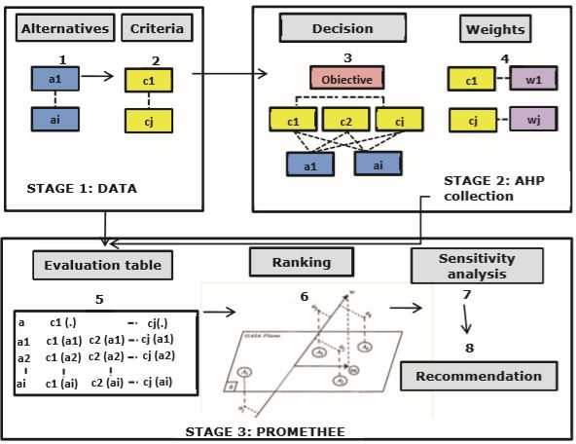
  INTEGRATION OF AHP-PROMETHEE
Fig: Algorithm for overall process

Slide 13
ALGORITHM OF OVERALL PROCESS
The search starts based on the ranking the user specifies. The background works on the AHP algorithm to first search on the weight basis to show the result.
The PROMETHEE algorithm further ranks individual weights on which the user enters thereby picking up an optimal solution.
The system provides an output of the most optimal search result finally

Slide 14
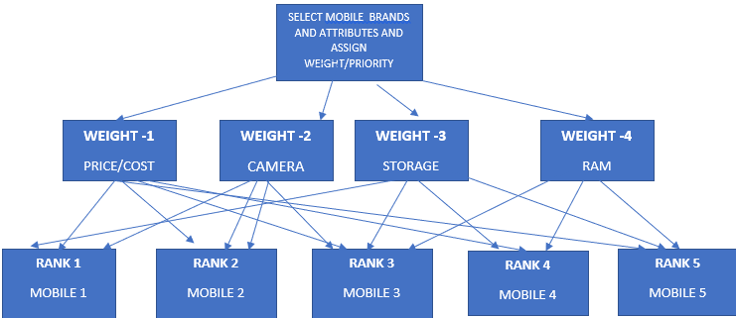
ALGORITHM OF OVERALL PROCESS
Fig: overview working result of AHP - ANALYTIC HIERARCHY PROCESS AND PROMETHEE ALGORITHM

Slide 15
ALGORITHM OF OVERALL PROCESS
Analytical Hierarchy Process (AHP) is used to assign weightage to the attributes ,which in turn is supplied as input to MCDM algorithms.
PROMOTEE- 1 & 2 algorithms are usually used to rank the products based on the assigned weightage These ranks are usually used to arrange the products according to customer preferences.
The PROMETHEE Algorithm is designed to rank the items that user has entered according to their priority.
preference function comparison between attributes
alternative comparison and criteria matrix partial ranking final ranking of mobiles

Slide 16
ALGORITHM OF OVERALL PROCESS
Steps involved in of AHP-PROMETHEE is as follows:
Step1: Data Collection (mobile brands, price, camera, RAM, ROM,display, processor, android version) User enters their specified data in the required fields.
Step2: Application of AHP (assigning weights and decision)
The AHP algorithm provides a weight for each of the parameter the user enters. The further weightage-based filtering now takes place.
Step3: Application of PROMETHEE
The System flow describes the flow of processes in the system architecture which details the view of data flow from one component to another.

Slide 17
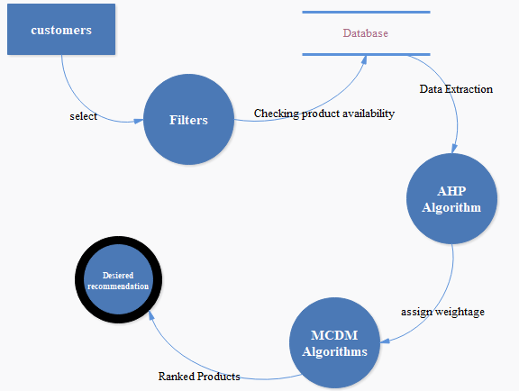
SYSTEM FLOW
Fig: dataflow diagram of the proposed system works

Slide 18
RESULTS AND DISCUSSION
The system provides an integrated platform with accurate and optimal search results in an mobile purchase e-commerce websites
It enables the customer to view selected items based on their requirements.
This platform will suggest several recommendations based on the weightage given by the user for the filters
The usage of weighted attributes in Multi-Criteria Decision Making (MCDM) Algorithms will rank the products based on the user’s expectation.
This will make the user feel more comfortable and be precise while they are purchasing with the help of this proposed system’s recommendations.

Slide 19
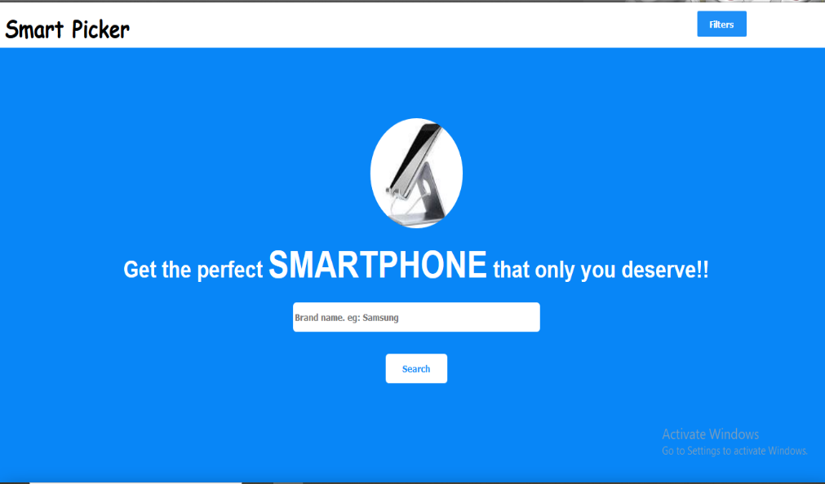
SNAPSHOTS
Fig Home page of the mobile recommender site

Slide 20
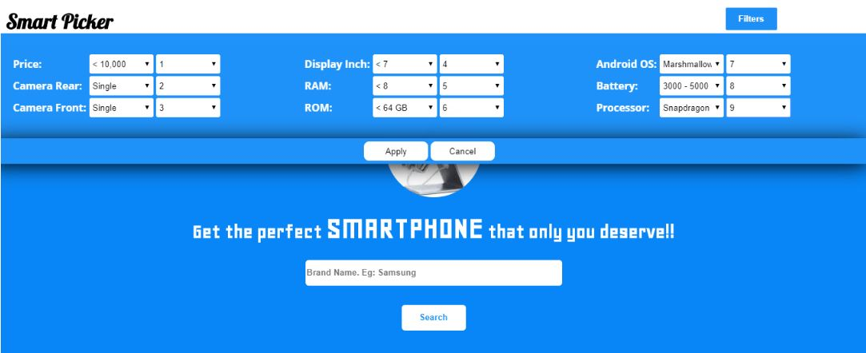
SNAPSHOTS
Fig Depicts the User Search Filter Page where users can Search through the optimized attributes.

Slide 21
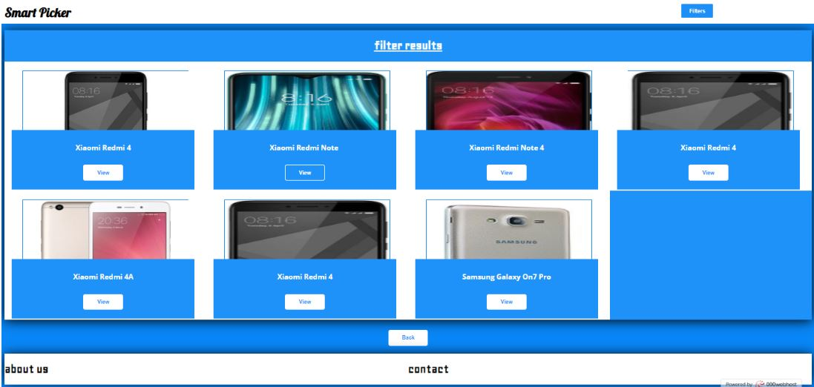
SNAPSHOTS
Fig Represents the accurate search results.
.

Slide 22
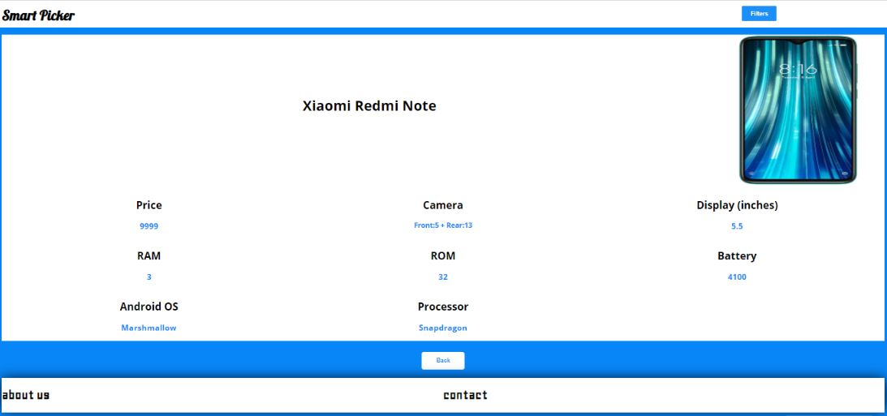
SNAPSHOTS
Fig Represents the selected Mobile Phone with its features
.

Slide 23
CONCLUSION
Advancement in search and filter methods has to check out parametric conditions and necessities of user’s interest accurately for tomorrow.
Maintaining and keeping up accuracy to a standard is always tougher and troublesome with time. Some of the challenges can be anticipated, such as advances in algorithmic conversions that are making it easier to provide accurate search results from database.
Here MCDM is being utilized to work around the basic shortcomings in user search results.
As the confirm mechanism for searching our view could be suitable and accurately used. Similarly, we have also developed a system that does not allow any user from getting diverted from the search they wanted to perform.

Slide 24
REFERENCES
[1]Beynon, Malcolm & Barton, Harry. (2008). A PROMETHEE based uncertainty analysis of UK police force performance rank improvement. International Journal of Society Systems Science. 1. 176-193. 10.1504/IJSSS.2008.021918.
[2]Athawale, Vijay & Chakraborty, Shankar. (2010). Facility Layout Selection Using PROMETHEE II Method.
[3]Zeng, Z. (2010). A Commodity Information Search Model of E-Commerce Search Engine Based on Semantic Similarity and Multi-Attribute Decision Method.
[4]P.Taillandier and S. Stinckwich, "Using the PROMETHEE multi-criteria decision making method to define new exploration strategies for rescue robots," 2011 IEEE International Symposium on Safety, Security, and Rescue Robotics, Kyoto, 2011, pp. 321-326.
[5]Balali, Vahid & Zahraie, Banafsheh & Roozbahani, Abbas. (2012). Integration of ELECTRE III and PROMETHEE II decision-making methods with an interval approach: Application in selection of appropriate structural systems. Journal of Computing in Civil Engineering. 28. 297-314. 10.1061/(ASCE)CP.1943-5487.0000254.

Slide 25
REFERENCES
[6]Khalaji, Majid. (2012). Improving Recommender Systems in E-Commerce Using Similar Goods. Journal of Software Engineering and Applications. 05. 96-101. 10.4236/jsea.2012.52015.
[7]Zhao, Hongju & Peng, Yi & Li, Wei. (2013). Revised PROMETHEE II for improving efficiency in emergency response. Procedia Computer Science. 17. 181–188. 10.1016/j.procs.2013.05.025.
[8]Achimugu, Philip &amp; Selamat, Ali &amp; Ibrahim, Roliana. (2014). A Web-Based Multi-Criteria Decision Making Tool for Software Requirements Prioritization. 10.1007/978-3-319-11289-3_45.
[9]Adunlin, G., Diaby, V., &amp; Xiao, H. (2015). Application of multicriteria decision analysis in healthcare: a systematic review and bibliometric analysis. Health expectations : an international journal ofpublic participation in health care and health policy, 18 6, 1894-905 .
[10]Mühlbacher, Axel &amp; Kaczynski, Anika. (2015). Making Good Decisions in Healthcare with Multi-Criteria Decision Analysis: The Use, Current Research and Future Development of MCDA. Applied healtheconomics and health policy. 14. 10.1007

Slide 26
REFERENCES
11]Srivastava, Abhishek & Singh, Bhakti & Chabra, Anshul & Majumdar,. (2017). Application and use of MCDM technique in software industry. 487-491. 10.1109/ICTUS.2017.8286058.
[12]Danesh, Darius & Ryan, Mike & Abbasi, Alireza. (2017). A Systematic Comparison of Multi-criteria Decision Making Methods for the Improvement of Project Portfolio Management in Complex Organisations. International Journal of Management and Decision Making. 16. 1. 10.1504/IJMDM.2017.10005690.
[13]Oses, U. & Roji, Eduardo & Cuadrado, J. & M., Larrauri. (2018). Multiple-Criteria Decision-Making Tool for Local Governments to Evaluate the Global and Local Sustainability of Transportation Systems in Urban Areas: Case Study. Journal of Urban Planning and Development. 144. 10.1061/(ASCE)UP.1943-5444.0000406.
[14]Roy, Sharmistha. (2018). COMPARATIVE STUDY OF SOME MCDM TECHNIQUES FOR E-COMMERCE APPLICATIONS. International Journal of Advanced Research in Computer Science. 9. 440-443. 10.26483/ijarcs.v9i1.5361.
[15]Frini, Anissa & Sirois, Caroline & Laroche, Marie-Laure. (2020). A Hybrid Delphi Multi-criteria Sorting Approach for Polypharmacy Evaluations. 10.1007/978-981-32-9808

Slide 27
THANK YOU

